Slide 1
Consolidated balance sheet of holding company
DR. MANOJ MISHRA
Vivekanand Mahavidyalaya
Raipur

Slide 2
Meaning HOLDING COMPANY IS THAT COMPANY WHICH HAS A SUBSIDIARY COMPANY.
SUBSIDIARY COMPANY MEANS A COMPANY WHICH HAS A HOLDING COMPANY.
CONSOLIDATION WHEN BALANCE SHEET OF HOLDING COMPANY AND SUBSIDIARY COMPANY MAKE TOGETHER IT IS KNOWN AS CONSOLIDATED BALANCE SHEET.

Slide 3
Process to make consolidated balance sheet
1 calculation of ratio
RATIO = NO. OF EQUITY SHARE BY HOLDING COMPANY
AND
NO. OF REMAINING SHARE WITH SUBSIDIARY COMPANY
2 .calculation of pre acquisition profit or loss (Capital profit/capital loss) profit/reserves of subsidiary company at the of acquisition of there share by holding company is known as Capital profit
3 calculation of post acquisition profit /loss(REVENUE
PROFIT) profit and loss of subsidiary company after the date of acquisition of share by holding company is known as revenue profit.

Slide 4
Calculation of cost of control
Control means what is the cost of become a holding company
If excess payment made IT is become a goodwill
If less it is known as capital reserve
THE PROCESS TO CALCULATE GOODWILL OR CAPITAL RESERVE
PARTICULAR. AMOUNT
VALUE OF INVESTMENT ——————-
Less 1 Nominal value of share acquired
By holding company. ++++++++
2 capital profit of holding company. ++++++++
———————————-
GOODWILL. (+) ————
Capital reserves. (-) ———+
———————————.

Slide 5
Calculation of minority’s interest
Minority means it means who is less in numbers
In CBS Holding company acquired share in subsidiary company and the no. Of share which is not acquired by holding company is known as minority’s share.
Calculation
Particular. Amount
Nominal value of share. ——————
Capital profit/capital loss of minority. —————-
Revenue profit/revenue loss. ——————
TOTAL MINORITY INTEREST. ——————-

Slide 6
Calculation of consolidated profit
Particular. Amount
Balance of profit/loss of holding company ————-
Revenue profit of holding company. ————
TATAL. —————-

Slide 7
Notes to prepare consolidated balance sheet
1 All fixed assets of holding and subsidiary
2 All current assets of holding and subsidiary (debtors,bank,cash,b/T-short term investment etc.)and current liabilities
Excluded the following
1 share capital of subsidiary company
2 profit and reserves of subsidiary company
3 investment of holding company
The following items to be included
1 minority interest
Consolidated profit

Slide 8
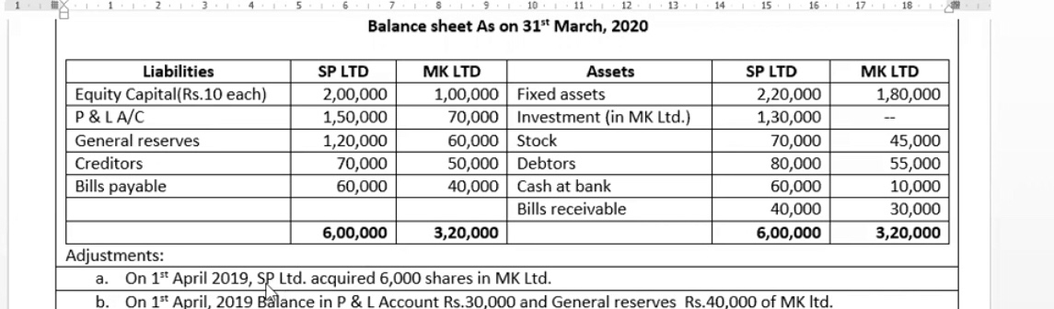
QUESTION

Slide 9
Solution
1 SP LTD. HOLDING COMPANY
2 ML LTD. SUBSIDIARY COMPANY
CALCULATION OF RATIO MK LTD.HAVING SHARE CAPITAL OF RS. 100000 of Rs 10 each.Tatal no. Of share 100000/10=10000 share,out of which 6000 acquired by holding company.Remaining no. Of share will be 4000 ;(10000-6000)
RATIO = 6000:4000 OR 6:4 or 3:2
Share of holding company 3/5 and minority 2/5

Slide 10
Calculation of capital profit
Profit of mk Ltd.as on 31/03/2020 Rs.70000
Profit of mk Ltd.as on 01/04/2019 Rs.30000
Reserves of mk Ltd as on 31/03/2020Rs.60000
Reserve of mk Ltd as on 01/04/2019 Rs.40000
Date of acquisition of share 01/04/2019 profit and reserve of subsidiary company up to 01/04/2019 will be known as capital profit
Capital profit = profit up to 01/04/2019 +reserves up to 01/04/2019
Capital profit =30000+40000=70000
Share of holding company =70000*3/5=42000
Share of minority =70000*2/5=28000

Slide 11
Calculation of Revenue profit
Profit and reserves of mk. Ltd after the date of acquisition of share known as Revenue profit.
Profit up to 31/03/2020 Rs.70000
Profit up to 01/04/2019 Rs.30000
Profit after the date of acquisition (70000-30000)=40000
Reserve up to 31/03/2020 Rs.60000
Reserve up to 01/04/2019 Rs.40000
Reserve after the date of acquisition of share(60000-40000)=20000
Revenue profit =40000+20000=60000
Holding co.60000*3/5=36000,minority 60000*2/5=24000

Slide 12
Calculation of cost of control
Particular. AMOUNT
VALUE OF INVESTMENT Rs.130000
Less :Nominal value of share acquired. (60000)
Capital profit of holding company. (42000)
——————-
GOODWILL. +28000
———————

Slide 13
Calculation of minority interest
Particular. Amount
Nominal value of share. Rs.40000
Capital profit of minority. Rs.28000
Revenue profit of minority. Rs.24000
————————
Rs.92000
————————

Slide 14
Calculation of consolidated profit
Particular Amount
Profit of holding company. Rs.150000
Revenue profit of holding company. Rs.36000
———————
Rs.186000
———————-

Slide 15
Consolidated balance sheet
Particular. Amount
1 EQUITY AND LIABILITIES
Shareholder fund:
Share capital. Rs.200000
Reserve&surplus. Rs.306000
Minority interest. Rs.92000
Current liabilities
Creditors. Rs.120000
Bills payble. Rs.100000
—————————
Rs.818000
————————-

Slide 16
Consolidated balance sheet
II ASSETS
Non current assets
Fixed assets
Tangible assets Rs.400000
Intangible assets. Rs.28000
Current assets
Stock. Rs115000
Debtors. Rs.135000
Cash in hand Rs 70000
Bills receivables. Rs.70000
Rs,8180000

Slide 17
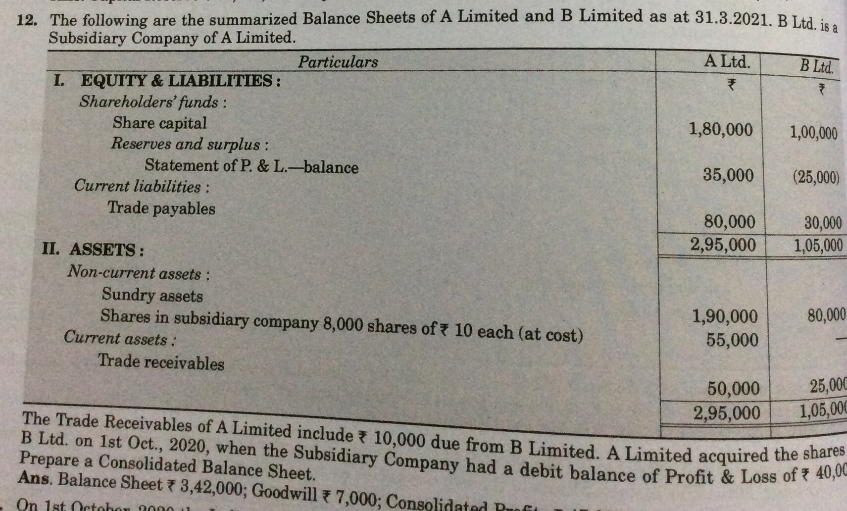
Question no. 12

Slide 18
Solution
Calculation or ratio. =1 share capital of B Ltd Rs.100000
2 price of one share Rs. 10
No. Of equity share of B Ltd 100000/10=10000 share
No. Of equity share acquired by holding company =8000
No. Of remaining share =10000- 80000=2000share
Ratio =8000:20000 or 4:1
Holding 4/5 and minority 1/5

Slide 19
Calculation of capital profit/capital loss
DATE OF ACQUISITION OF SHARE 01/10/2020
On 01/10/2020 the debit balance of B Ltd Rs.40000(loss)
Capital losss =Rs.40000
Holding company =40000*4/5=Rs.32000
Minority =40000*1/5=Rs.8000

Slide 20
Calculation of revenue profit/revenue loss
Profit of B Ltd as on 31/03/2021 (25000)(loss)
Profit of B Ltd.as 01/10/2020. (40000)(loss)
Profit from 01/10/2020 to 31/03/2021 = -25000 – (-)40000
=-25000+40000=+15000
Holding company =15000*4/5=12000
Minority =15000*1/5=3000

Slide 21
Calculation of cost of control
Particular. Amount
Value investment. Rs.55000
+ capital loss of holding company. Rs.32000
—————
Rs.87000
Nominal value of share of share acquired. (Rs.80000)
————-
GOODWILL. +7000
—————

Slide 22
Calculation of Minority interest
Nominal value of share. Rs..20000
Capital loss. (Rs. 8000)
Revenue profit. Rs.3000
—————-
Rs.15000
————- ——

Slide 23
Consolidated profit
Particular. Amount
Balance of profit of A Ltd. Rs.35000
Revenue profit of of holding company. Rs.12000
Rs.47000

Slide 24
Consolidated balance sheet
EQUITY AND LIABILITIES
Shareholders fund
Share capital. Rs.180000
Reserve & surplus. Rs.47000
Minority interest. Rs.15000
Current liabilities
Trades payble. Rs.100000
———————-
Rs.342000
———————

Slide 25
Consolidated balance sheet
Assets
Non current assets
Fixed assets
Tangible assets
Sundery assets. Rs.270000
Intangible assets. Rs.7000
Current assets
Trade receivables. Rs.65000
Rs.342000

Slide 26
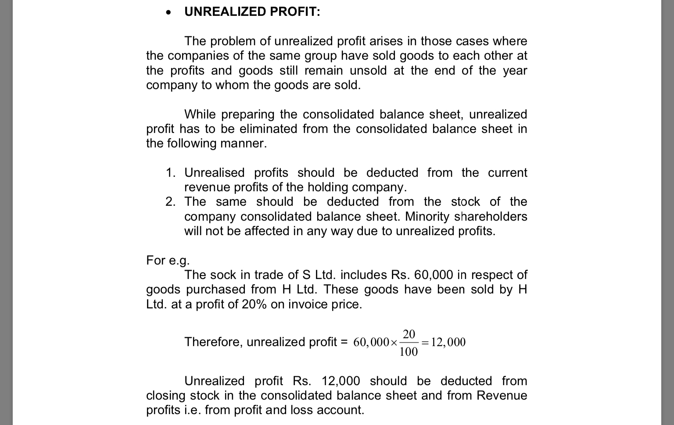
UNREALISED PROFIT

Slide 27
Condition for calculating unrealized profit
1 good sold at profit by holding to subsidiary or by subsidiary company to holding company.
2 goods remain unsold at the end of the year.
UNREALISED profit =
goods included in stock *R/100 (selling price)
OR
GOODS INCLUDED IN STOCK *R/100+R ( at cost price)

Slide 28
Question no.15
1 A Ltd. Purchase goods from B Ltd.
2 B Ltd charge profit 20% on sale price
3 goods included in stock Rs.20000
UNREALISED PROFIT =20000*20/100=4000
Share of holding company =4000*4/5=3200
B Ltd puchase goods from A Ltd.
B Ltd charge 20% profit on cost
Goode included in stock Rs.30000
Profit =30000*20/120= 5000
Share of holding company 4/5
UNREALISED profit=5000*4/5=4000

Slide 29
Question no.16
1 Ratio - Nil (all share are acquired by holding company)
Capital profit- date of acquisition of share 01/04/2020
General reserve up to 01/04/2020 Rs.2000
Balance of p/L up to 01/04/2020 Rs. Nil
Total capital profit =2000+nil=2000
Revenue profit- after the date of acquisition
General reserve =nil
Profit and loss= 36000
Total revenue profit =36000

Slide 30
Calculation of cost of control
Particular. Amount
Value of investment. 105000
Less- 1 nominal value of share. (45000)
2 capital profit of holding company. (2000)
goodwill. 58000

Slide 31
Minority interest
Particular. Amount
Nominal value of share. Nil
Capital profit. Nil
Revenue profit. Nil
Total. Nil

Slide 32
UNREALISED PROFIT
Percentage of profit on cost 20%
Goods included in stock Rs. 3000
UNREALISED profit =3000*25/125=600

Slide 33
Consolidated balance sheet
1 EUQITY AND LIABILITIES
SHAREHOLDER FUND
SHARE CAPITAL. 300000
Reserve and surplus
General reserve. 100000
Statement of profit and loss. 125400
Current liabilities
Trades payble. 19000
544400

Slide 34
Consolidated balance sheet
ASSETS
NON CURRENT ASSETS
FIXED ASSETS
TANGIBLE ASSETS
FREEHOLD PREMISES. 193000
Machinery. 96000
Intangible assete 58000
Current assets
gInventory. 79400
Trade receivables. 44000
Cash in hand and equivalent. 74000
544400

Slide 35
Notes to account
Share capital
3000 equity share of Rs.10 each Rs. 300000
Reserve and surplus
General reserve. Rs.100000
Statement of profit and loss. Rs. 125400
Trade payble
A Ltd. Rs.5000
B Ltd. Rs.14000
Rs.19000
Inventory
A Ltd. 61400
B Ltd. 18000
79400

Slide 36
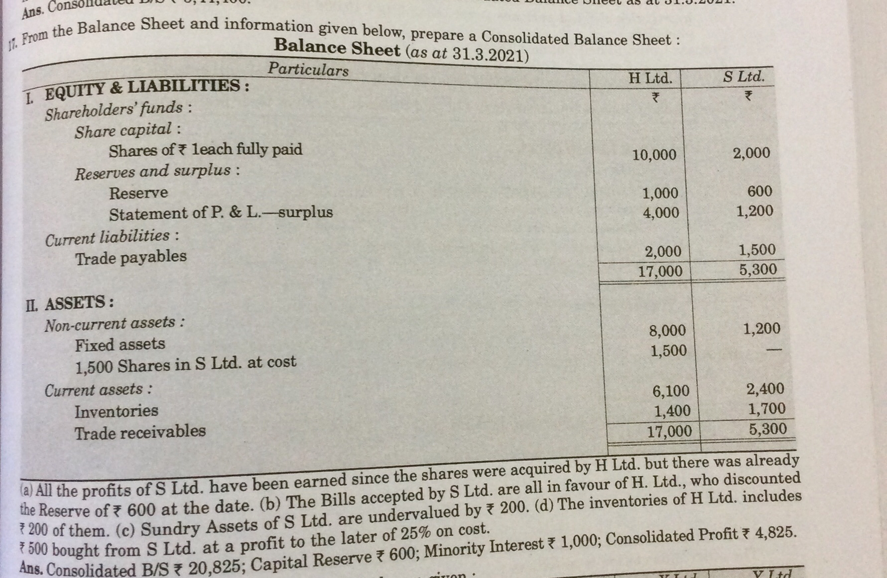
Question no 17

Slide 37
Solution
1 Ratio -1 share capital of s Ltd.Rs.2000
2 price per share Rs 1
3 no. Of share 2000/1=2000 share
4 no. Of share acquired by H Ltd.1500
5 no of remaining share 2000-1500=500share
Ratio= 1500:500 or 3:1
2 capital profit 1 General reserve Rs.600
2 under valuation of assets Rs.200
3 total 600+200=800
2 Holding co.800*3/4=600 800*1/4=200
Note- if assets are under valued added to capital profit and overvalued deduct from capital profit.

Slide 38
Revenue profit – profit and loss Rs.1200
. 1 Holding company 1200*3/4=900
2 Minority 1200*1/4=300
Cost of control- value of investment. Rs.1500
Less –nominal value of share. (1500)
Capital profit of holding co. (600)
Capital Reserves. (600)

Slide 39
Minority interest
Nominal value of share. Rs.500
Capital profit of minority. Rs.200
Revenue profit of minority. Rs.300
Total Rs.1000

Slide 40
UNREALISED profit
H Ltd.purchase goods from S Ltd.
Profit 25% on cost price
Goods included in stock Rs.500
UNREALISED profit =500*25/125=100
Share of holding co.100*3/4=75
Note Rs.75 deducted from profit as well inventory of H Ltd.

Slide 41
Consolidated balance sheet
EQU ITY AND LIABILITIES
SHAREHOLDER FUND
SHARE CAPITAL. RS.10000
Reserve and surplus Rs.6426
Minority interest. Rs.1000
Current liabilities
Trade payble.
Creditors. Rs.3200
Bills payble. Rs.200
Rs.20825
/.

Slide 42
Consolidated balance sheet
Assets
Non current assets
Fixed assets
Tangible assets Rs.9400
Current assets
Inventory. Rs.8425
Trade receivables.
Debtors. Rs.3000
Bills receivables. Nil
Rs.20825

Slide 43
Notes to account
Share capital
10000 share of Rs. 1 each. 10000
Reserve and surplus
General reserve. 1000
Statement of profit and loss. 4825
Capital reserve. 600. 6425
Trade payble
Creditors
H Ltd. 2000
S Ltd. 1200. 3200
Bills payble
H Ltd. nil
S Ltd. 300
Less contras. (100). 200
(3400)

Slide 44
Question no. 18
1 Ratio – 15000:10000 Or 3:2
2 Capital profit- date of acquisition 30/09/2020
General reserve up to 01/04/2020 -60000
General reserve from 01/04 to 30/09 20000*6/12=10000
P/L up to 01/04/2020. 40000
P/L from 01/04 to 30/09 70000*6/12=35000
Total capital profit =60000+10000+40000+35000=145000
X Ltd. 145000*3/5=87000
Minority 145000*2/5=58000

Slide 45
3 Revenue profit (from 30/09 /2020 to 31/03/2021)
General reserves (60000+20000-60000-10000)=10000
P/L (40000+70000-40000-35000). =35000
Total 10000+35000=45000
XLtd.45000*3/5=27000
Minority =45000*2/5=18000

Slide 46
4 cost of control
Value of investment. 190000
Less nominal value of share. (150000)
Capital profit of holding co. (87000)
Capital reserve. 47000

Slide 47
5 minority interest
Nominal value of share. 100000
Capital profit. 58000
Revenue profit. 18000
Total. 176000

Slide 48
UNREALISED profit
Profit = 10000*25/125=2000
Holding co. 2000*3/5=1200

Slide 49
Consolidated balance sheet
EQUITY AND LIABILITIES
SHAREHOLDER FUND
SHARE CAPITAL. 1000000
Reserve and surplus 435800
Minority interest. 176000
Current liabilities
Trade payble. 360000
1971800

Slide 50
Consolidated balance sheet
ASSETS
NON CURRENT ASSETS
FIXED ASSETS 1000000
Intangible assets
Goodwill. 103000
Investment. 50000
Current assets
Inventory. 298800
Trade receivables. 390000
Cash and cash equivalents. 130000
1971800

