Slide 1
INVESTMENT MANAGEMENT
Dr. A. K. Jha
Head of Management Department

Slide 2
Introduction
Asset management is the service of professionally investing money
The largest segment of the asset management in the United States is made up of registered investment companies.
These companies managed $18.2 trillion in assets at year-end 2014, largely on behalf of more than 90 million U.S. retail investors.
The industry has experienced strong growth over the past quarter century from asset appreciation and strong demand from households due to rising household wealth, evolution of employer-based retirement systems, and endowed assets, etc.

Slide 3
Top Five Investment Management Firms
Rank | Primary Business Name | Total AUM ($ bill)
1 | Vanguard Group Inc. | $3,006.42
2 | Pacific Investment Management Co, LLC. | $1,680.39
3 | Capital Research and Management Co. | $1,366.31
4 | JP. Morgan Asset Management | $1,149.34
5 | FMR Co, Inc. | $918.63

Slide 4
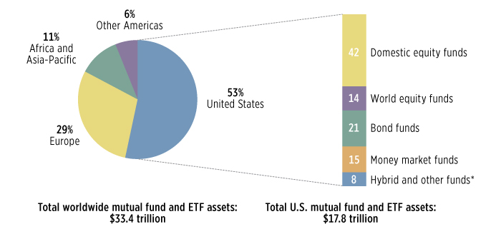
World Largest Mutual Fund and ETF market in the USA

Slide 5
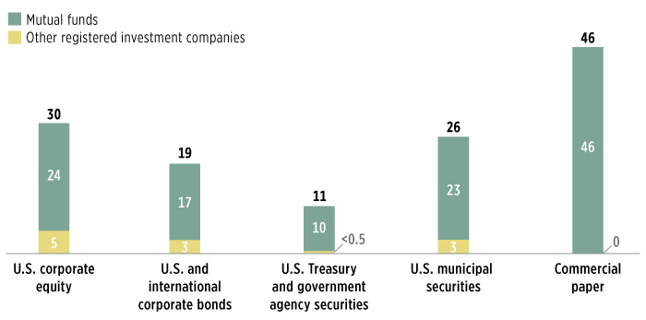
Investment World of Investment Companies Source: ICI

Slide 6
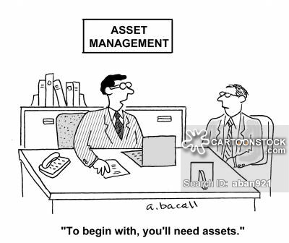
Who are the Investors?

Slide 7
Institutional Investors
  Pension Funds
    Defined-Benefit Plans
    Defined-Contribution Plans
    Hybrid and other Plans
  Foundations and Endowments
    Foundations
    Endowments
  The Insurance Industry
    Life Insurance Companies
    Non-Life Insurance Companies
  Banks and other Institutional Investors

Slide 8

Portfolio Management as a Process

Slide 9
Portfolio Management as a Process
  Portfolio management is an integrated set of steps undertaken in a consistent manner to create and maintain appropriate combination of investment assets.
    Planning Step
      Investor’s Objectives and Constraints
      Investment Policy Statement (IPS)
      Forming Capital Market Expectations
      Creating Strategic Asset Allocation
    Execution Step
      Portfolio Construction and Revision
      Portfolio Optimization
      Tactical Asset Allocation
    The Feedback Step
      Monitoring and Rebalancing
      Performance Evaluation

Slide 10
Investment Objectives
Risk Objective largely determines return objective
  How to measure risk?
    Absolute vs Relative
    Downside Risk: Value at Risk (VaR)
  What is the investor’s willingness to take risk? Institutional vs. Individual
  Investor’s ability to take risk?
Return Objectives
  How is Return Measured? Total/Nominal/Real
  Stated Return Desire
  Required Return

Slide 11
Investment Constraints
Liquidity
Time Horizon
Tax Concerns
Legal and Regulatory Factors
Unique Circumstances

Slide 12
Defined-Benefit (DB Plan)
  Plan sponsor is obligated in terms of the benefits to plan participants.
    Promise made by a plan sponsor generates a future financial liability or “pension liability”.
  Return Objective
    To achieve returns that adequately fund pension liabilities
    Overhang of trillion dollars liabilities
  Risk:
    DB plans payout of the pension assets, which are invested in the market.
      Market Risk
      Longevity Risk
      Liquidity Risk
      Funding status – under-funded/over-funded
      Overall low risk tolerance

Slide 13
Defined-Contribution (DC Plan)
Plan sponsor is obligated in terms of contribution to pension fund rather than benefits to plan participants.
  Promise for DC Plan is for the current stage – there is no future financial liability.
  DC Plan sponsor bears the legal risk of investing
  DC plans are portable

Slide 14
Foundations
Usually grant making institutions funded by gifts and investment assets – usually created by single donor to fund philanthropic goals.
Investment portfolio provides the dominant source of revenue
Purchasing power of its corpus is either maintained or not.
US tax laws essentially mandate minimum level of annual spending.
Foundations can vary widely in their investment goals and time horizon.
Foundations, generally, don’t fundraise or reach out to donors.
Risk & Return Objectives:
  Foundations can have higher risk tolerance
  Most Foundations want to preserve corpus and target returns accordingly

Slide 15
Endowments
Long-term funds (inter-generational) generally owned by non-profit institutions like universities, hospitals, museums etc.
Preserve purchasing power of the principal gift and to use fraction of returns as spending for designated cause.
Risk & Return Objectives:
  Return objective is to provide significant, stable, and sustainable flow of funds to support designated programs.
  Risk is related to spending policy; Averaging rules dampen short term volatility while striving for long term target returns.
  Risk tolerance depends on the endowment’s role in operating budget.

Slide 16
Private Universities Ranked by June 30, 2012 Endowment Market Value
 |  |  | $Billions
1 |  | Harvard | 30.4
2 |  | Yale | 19.3
3 |  | Stanford | 17.0
4 |  | Princeton | 17.0
5 |  | MIT | 10.1
6 |  | Columbia | 7.7
7 |  | Northwestern | 7.1
8 |  | Pennsylvania | 6.8
9 |  | Chicago | 6.6
10 |  | Notre Dame | 6.3

Slide 17
Fy12 Endowment Spending as a % of the Market Value

Slide 18
Risk Management as Process
Risk management is a process involving:
  Identifying Risk factors
  Quantification of exposure to risk
  Map various risks in to risk estimation calculation
  Identify overall risk exposure
  Continuous measurement of exposure
  Adjustment to exposure according to agreed risk exposure limits
  Alteration based on new information

Slide 19
Portfolio Risk Universe
Systematic Risk: Influences large number of assets, difficult to diversify
Unsystematic risk: Influences small number of assets, manageable
Credit and Default Risk: Associated with Bonds and Stocks
Geo-political Risk: Related to policies and internal situation of a region or country
Foreign Exchange Risk: due to financial policies of various countries
Interest Rate Risk: Related to Fed policy
Market Risk: Related to market volatility
Headline Risk: Avoid Bad Publicity

Slide 20
Asset Class
Traditional | Alternative
Stocks | Hedge Funds
Bonds | Private Equity
REITS | Private Real Estate
Commodities | Natural Resources

Slide 21
Asset Class Characteristics
Asset Class/Strategy | Risk | Characteristics
Public Equity | Market beta/high Volatility | High return/Growth
Private Equity | Illiquid/high Volatility | Higher return/Growth
Real Estate (REITS) | Market beta/high Volatility | High return/Growth/Inflation Protection
Real Estate (Private) | Illiquid/regional/Volatile | High return/Inflation protection
Bonds | Low Volatility | Low return/Risk minimizing
TIPS | Low Volatility | Low return/Inflation protection
Natural Resources/Real Assets | Illiquid | High Return/Inflation protection

Slide 22
Portfolio Construction: Risk Reward Trade-off
  Rational portfolio choices based on the efficient risk (Modern Portfolio Theory).
  Capital Markets Expectations
  Asset class and strategy diversification
  Use of quantitative methods in portfolio management
  Risk budgeting

Slide 23
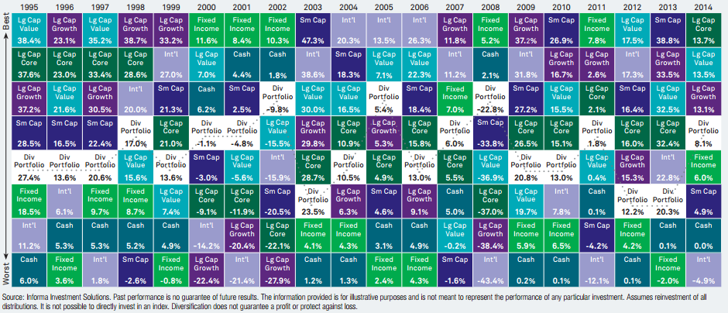
20-years Asset-Class Returns

Slide 24
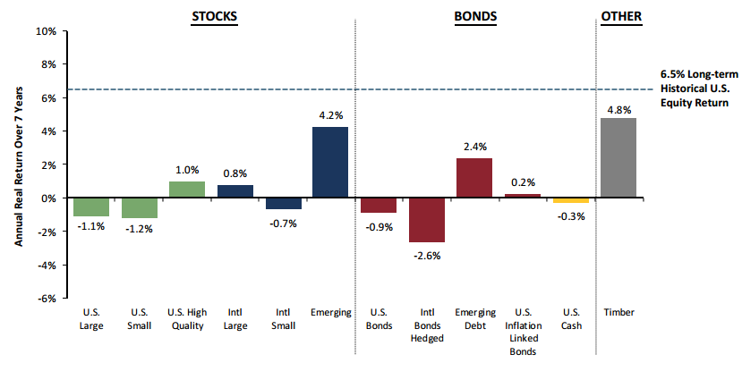
7-Year Asset Class Real Return Forecasts

Slide 25
Endowment Management
Investment Strategy Implementation
Manager searches
Manager evaluation
Investment Portfolio Monitoring
Portfolio risk management
Performance measurement
Performance reporting
Performance and attribution analyses
Capital markets monitoring
Other

Slide 26
Investment Risk Management
360 degree risk management
  Risk minimization is one of the three objectives
  Investment decisions are based on better risk adjusted returns and downside risk protection.
  Investment portfolio is diversified across asset classes, markets, and strategies to mitigate risk.
  Manager selection is based on stringent quantitative and qualitative due-diligence.
  Risk reporting is part of the culture

Slide 27
Types of Risks
Market Risk
Manager Performance Risk
Counter-party Risk
Manager Business Risk
Concentration Risk
Style drift Risk
Fraud Risk

Slide 28
Endowment Investment Return Goal
Return – Inflation – Spending – Admin fee > 0
- 2.5% - 4.25% - 2% > 0
?

Slide 29
UCONN Foundation

Slide 30
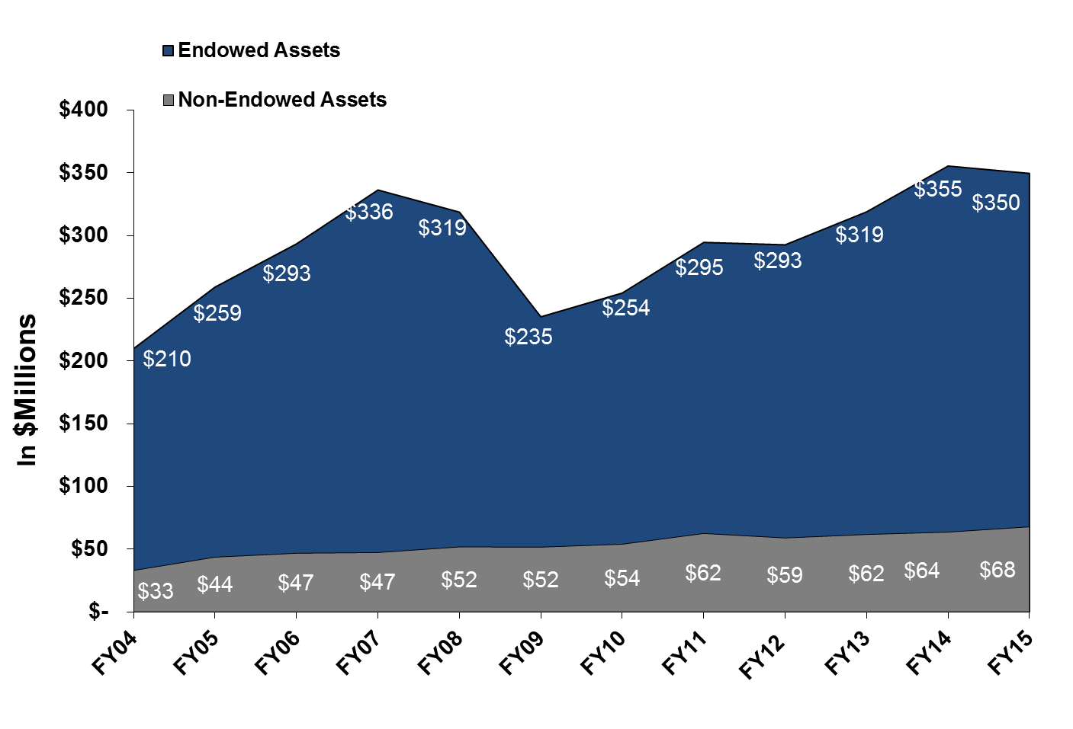
Managed Assets

Slide 31
Fiscal Year | Net Return
2007 | 16.76%
2008 | -5.55%
2009 | -19.87%
2010 | 9.04%
2011 | 15.47%
2012 | 0.67%
2013 | 8.52%
2014 | 12.93%
2015 | 2.04%
FYTD 2016 | 2.95%

Slide 32
UCONN Foundation

Slide 33
Policy Benchmark Composition
Asset | Benchmark | Weight
Global Equities | MSCI ACWI | 31.5%
Private Capital | PE Median TW | 14%
Long Short Equities | HFRI Equity Hedge Index | 11.5%
Global Macro | HFRI Macro Index | 4%
Event Driven | HFRI Event Driven Index | 2%
Real Estate | Weighted Public/Private Index | 6%
TIPS | TIPS | 5%
Natural Resources | Weighted Public/Private Index | 16%
Investment Grade | Barclay Aggregate | 1%
Relative Value | HFRI Relative Value Index | 9%
The Policy Benchmark mirrors the target portfolio allocation.
Indexes were chosen by consultants at Wilshire Associates and approved by IC.

Slide 34
Liquidity
The portfolio has a meaningful allocation to locked-up investments, to capture an illiquidity premium.
A large portion of the portfolio is super liquid and the majority of these assets can be liquidated in under three days.

Slide 35
Q & A

Slide 36
THANK YOU

